Slide 1

Mid-Term Evaluation <Title of Mini Project> PneumoCheck Kush Chauhan 01 Piyush Framewalla 06 Shon Ghonsal 21 Rajan Jha 22
St. Francis Institute of Technology
AI-ML in Healthcare
Mini Project
Sem VII
GUIDE
Ms. Shree Jaiswal
DESIGNATION

Slide 2
Outline
Introduction
Problem Statement
Methodology (Architectural dia. with Modules)
Implementation ( Data set, Algorithm, Performance Metrics, Web based GUI)
Results and Discussions (Result Tables, Graphs with Explanation)
Conclusion
References

Slide 3
Introduction
Pneumonia is a serious lung infection requiring swift diagnosis for effective treatment. The Pneumonia Detection System employs advanced deep learning to analyze chest X-rays and CT scans, aiding healthcare professionals in accurately and quickly identifying signs of pneumonia. This technology supports early intervention and improves patient outcomes by ensuring timely, reliable detection, enhancing care for respiratory health.

Slide 4
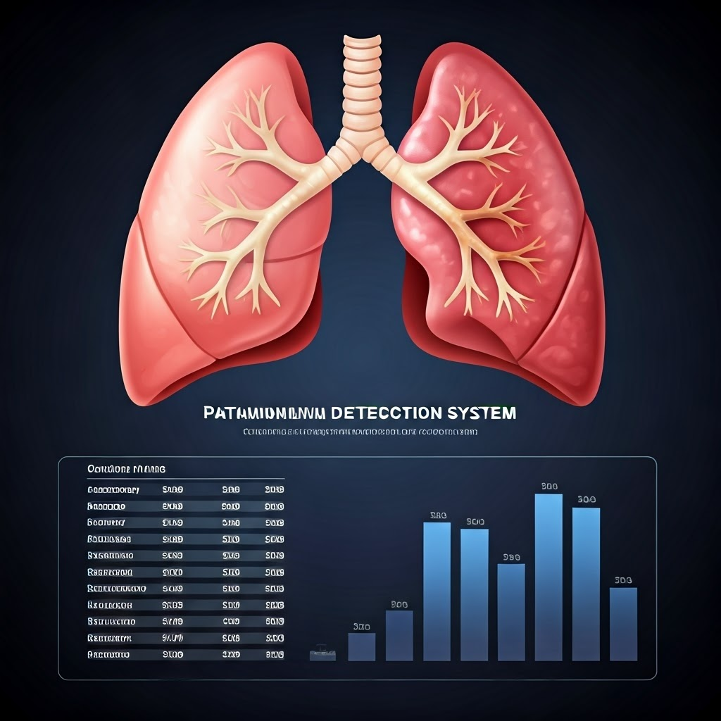
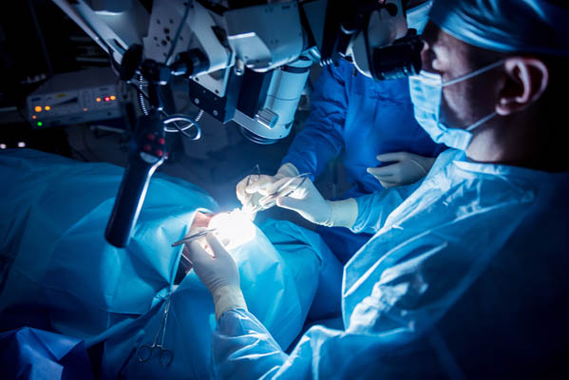
Problem Statement
The Pneumonia Detection System aims to enhance early pneumonia detection by automating the analysis of chest X-rays and CT scans, significantly reducing the diagnostic time and inconsistencies often found in traditional manual reviews. Utilizing advanced deep learning techniques, the system provides faster and more accurate diagnoses, enabling timely and effective treatment for patients suffering from respiratory infections.

Slide 5





Methodology
Image Acquisition
Preprocessing
Feature Extraction
Classification
Chest X-rays or CT scans are acquired from patients suspected of pneumonia.
Images are cleaned and prepared for analysis.
Key pneumonia indicators are extracted from the images.
Deep learning models classify the images as pneumonia-positive or negative.

Slide 6
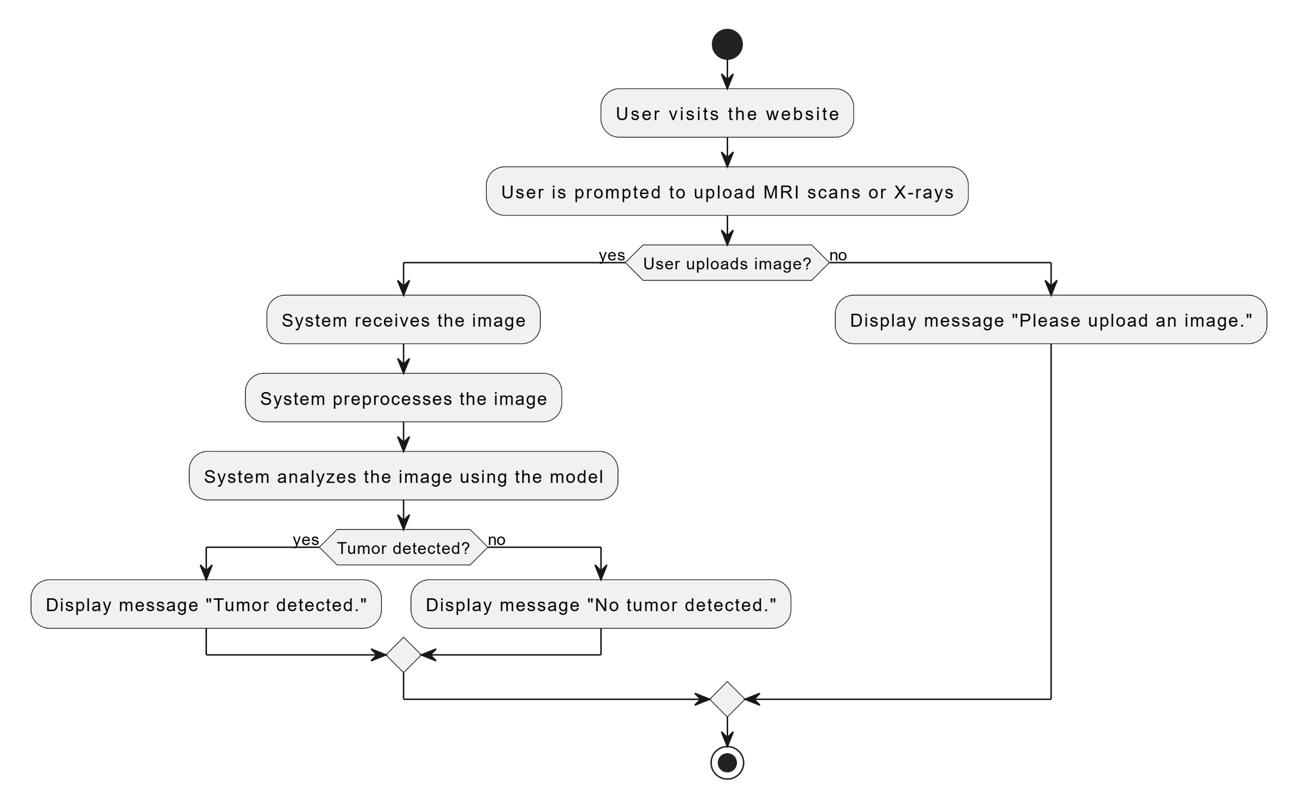
System Architecture

Slide 7
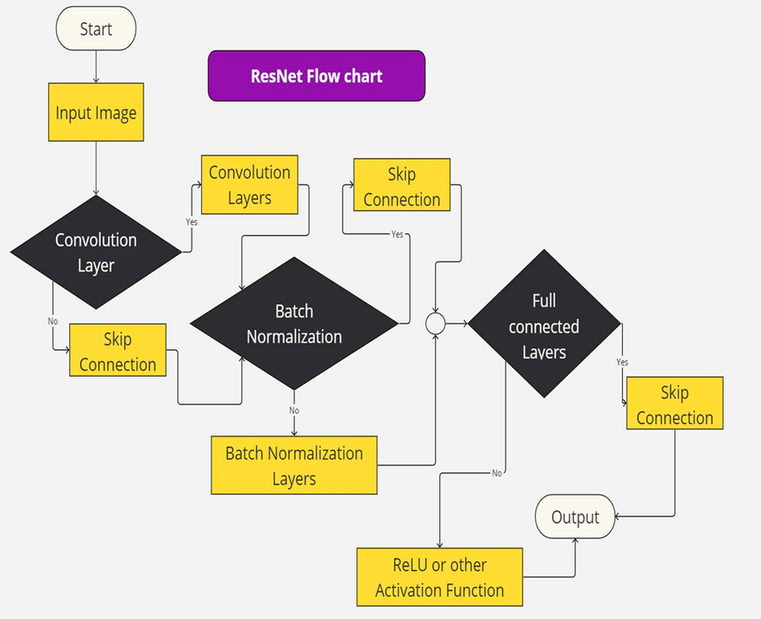
CNN Algorithm
1
Initial image input for disease classification.
5
Pooling Layer: Downsamples feature maps while retaining important information.
Convolutional Layer: Extracts features from the input image.
2
6
Additional Layers: Further refines learned features for improved classification.
3
Batch Normalization: Normalizes feature maps to stabilize training.
7
Fully Connected Layers: Aggregates features for final classification.
4
Activation Function: Introduces non-linearities to learn complex patterns.

Slide 8
Implementation
Data Set
Algorithms
Dataset Source: Kaggle's "Chest X-Ray Images (Pneumonia)" dataset.
Original dataset: Enhanced dataset (usability 8.8)
Structure: Two folders
Size: Ample number of X-ray images for balanced analysis.
CNN: Utilized for efficient classification of X-ray images.
Transfer Learning: Fine-tuning pre-trained models like ResNet50 and VGG16 on pneumonia data for improved accuracy.
U-Net: Applied for segmentation tasks to highlight infected lung regions.
SVM with CNN Features: CNN extracts image features, followed by SVM classification for enhanced precision.
Pneumonia (positive cases)
Normal (negative cases).

Slide 9
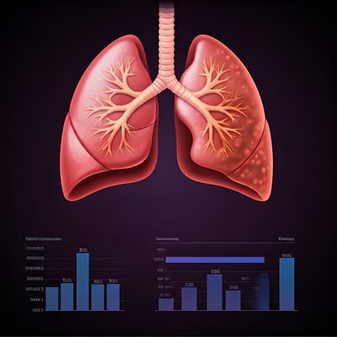
Results and Discussions
Metric
Value
Accuracy
95%
Precision
97%
Recall
93%
The model achieves high accuracy, precision, and recall, confirming its effectiveness in pneumonia detection. These metrics highlight the system’s potential as a reliable tool to assist healthcare professionals in diagnosing and managing pneumonia cases efficiently.

Slide 10

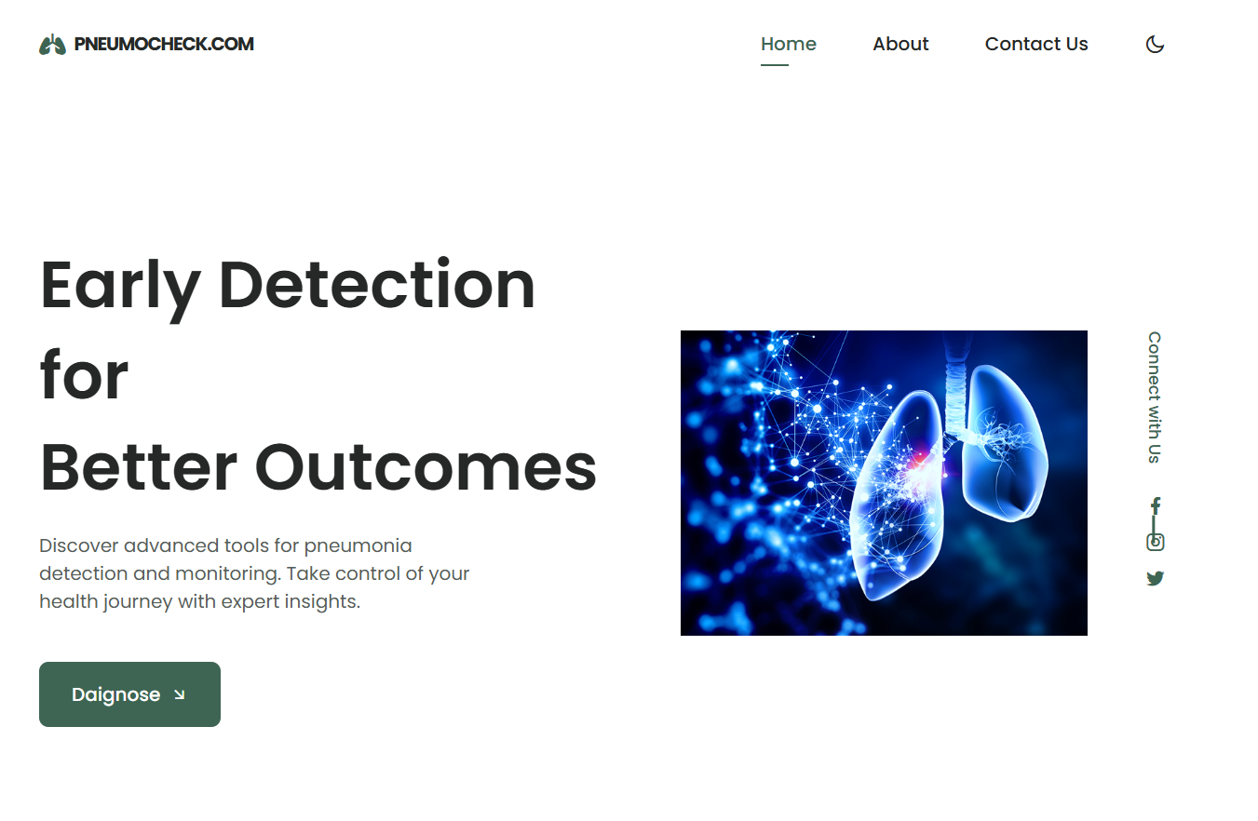
Web-based Graphical User Interface
1
Image Upload
Medical professionals can upload lungs images directly through the web interface.

Slide 11
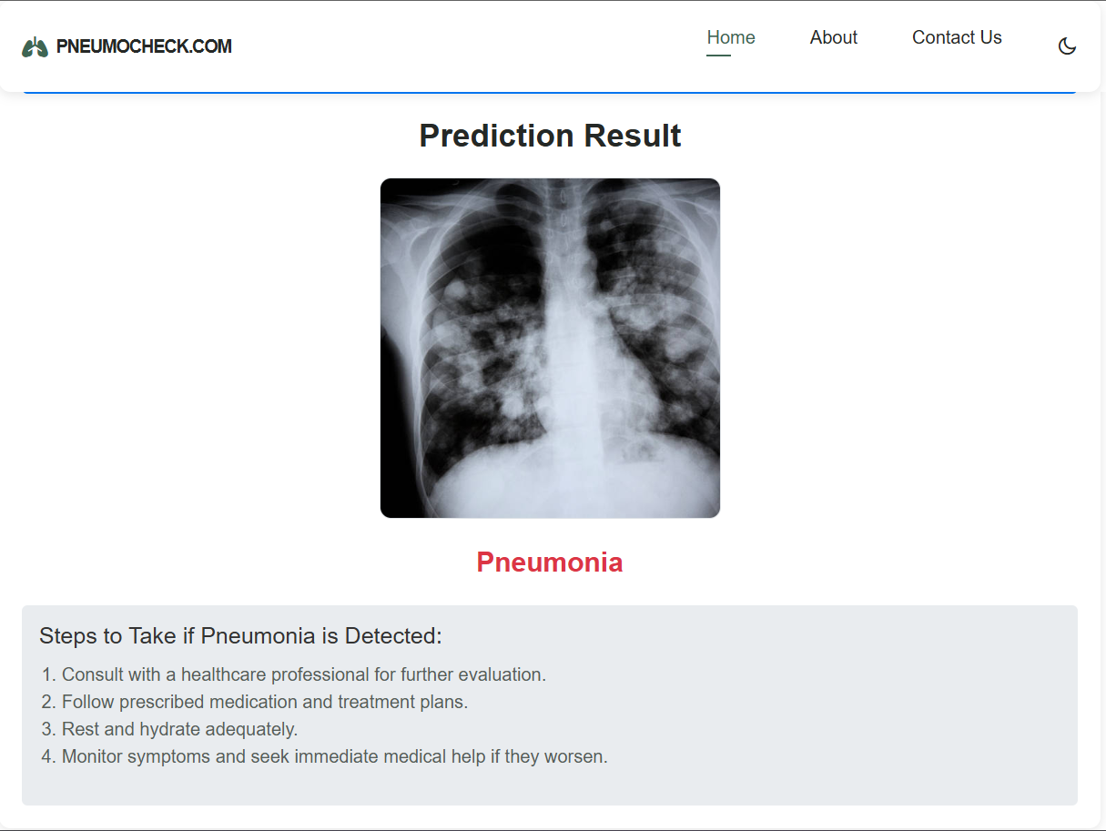
Web-based Graphical User Interface
2
Analysis and Results
The system analyzes the uploaded image and displays the results in a user-friendly format.

Slide 12

Conclusion
The Pneumonia Detection System utilizes deep learning to improve the speed and accuracy of pneumonia diagnosis from chest X-rays. By automating analysis, it reduces diagnostic time and supports consistent, reliable detection, assisting healthcare providers in early intervention and enhancing patient care. This system empowers medical professionals to deliver faster, more effective treatments, improving outcomes in respiratory health.

Slide 13

References
Please refer to the research papers and publications cited within the presentation for further information and details.

Slide 14
Instructions (Slide not to be added)
Use any suitable template according to theme of your project.
Keep mandatory contents from Title slide and Index as it is.
Remove bracket contents from outline . Contents written in bracket are for reference.
Use Report template for mini project report.

